Slide 1
TRAFFIC BUZZ
STATEMENT PROBLEM .1
Hectic Pune traffic Control System
For Localities of Pune

Slide 2
OUR IDEA
To find the path which take minimum time from source(student home) to reach COEP by using traffic density system.

Slide 3
WHAT WE ARE DOING?
We are creating a counter using a electric switch . This counter is fixed along with speed breaker.
And this speed breaker is fixed at a particular distance from traffic signal.
Whenever there is a red signal this counter starts and start counting number of vehicles gathering near signal . Maximum limit of counter is till, speed breaker.

Slide 4
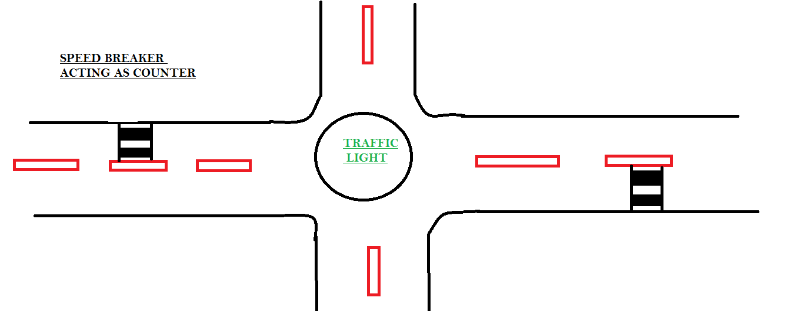
Schematic diagram

Slide 5
When car moves on speed breaker this completes the circuit and counts increases by 1.
On every road we are going to put this circuit and with help of GPS MODULE we can locate the different circuit .
User can access this value through android app.

Slide 6
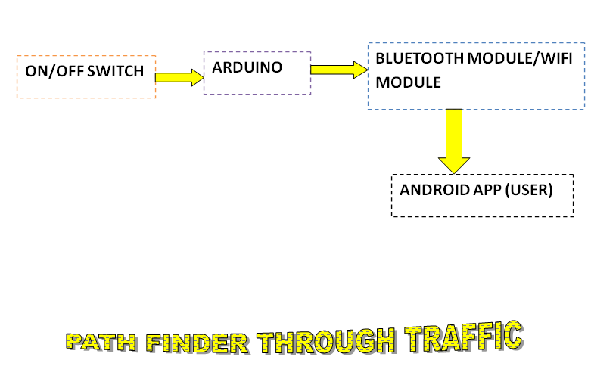
FLOW CHART

Slide 7
COST ANALYSIS
FOR 1 SIGNAL
Equipments required-
QUANTITY TOTAL
- arduino uno - 1 300
- wifi module- 1 150
- GPS module NEO -6M- 4 2800
TOTAL –Rs 3250

Slide 8
THANK YOU
SLOT NO -13

